Slide 1






FAKE NEWS IDENTIFIER
NLP, CLASSIFICATION AND TOPIC MODELLING
This Photo by Unknown Author is licensed under CC BY-NC

Slide 2

Fake News Matter..
Reduce the content’s credibility and reliability on websites.
Less readership means less advertising revenue.

Slide 3

Dataset Information
16K entries of news content from various sources, labelled with real and fake.
Crosschecked with Politic Fact.

Slide 4



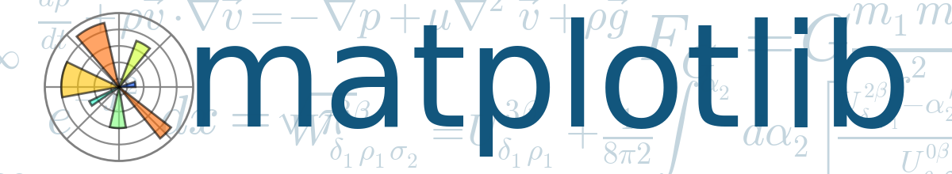




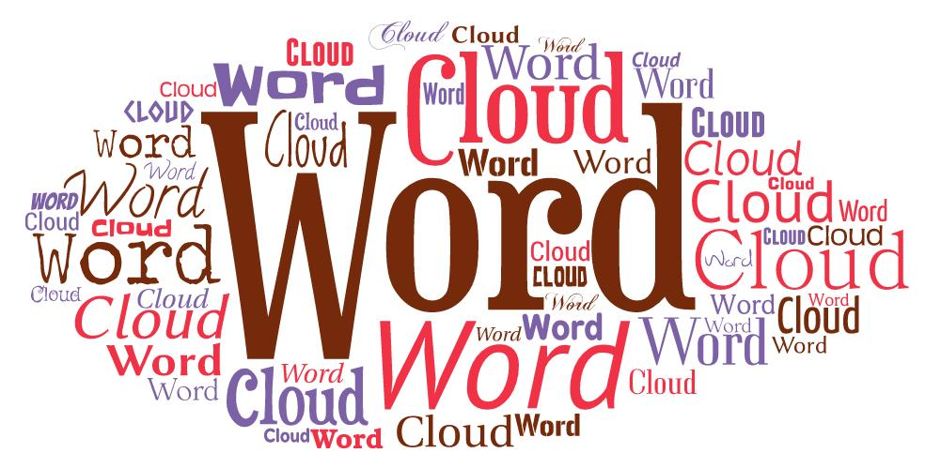
Exploratory Data Analysis
Modelling
Visualization

Slide 5
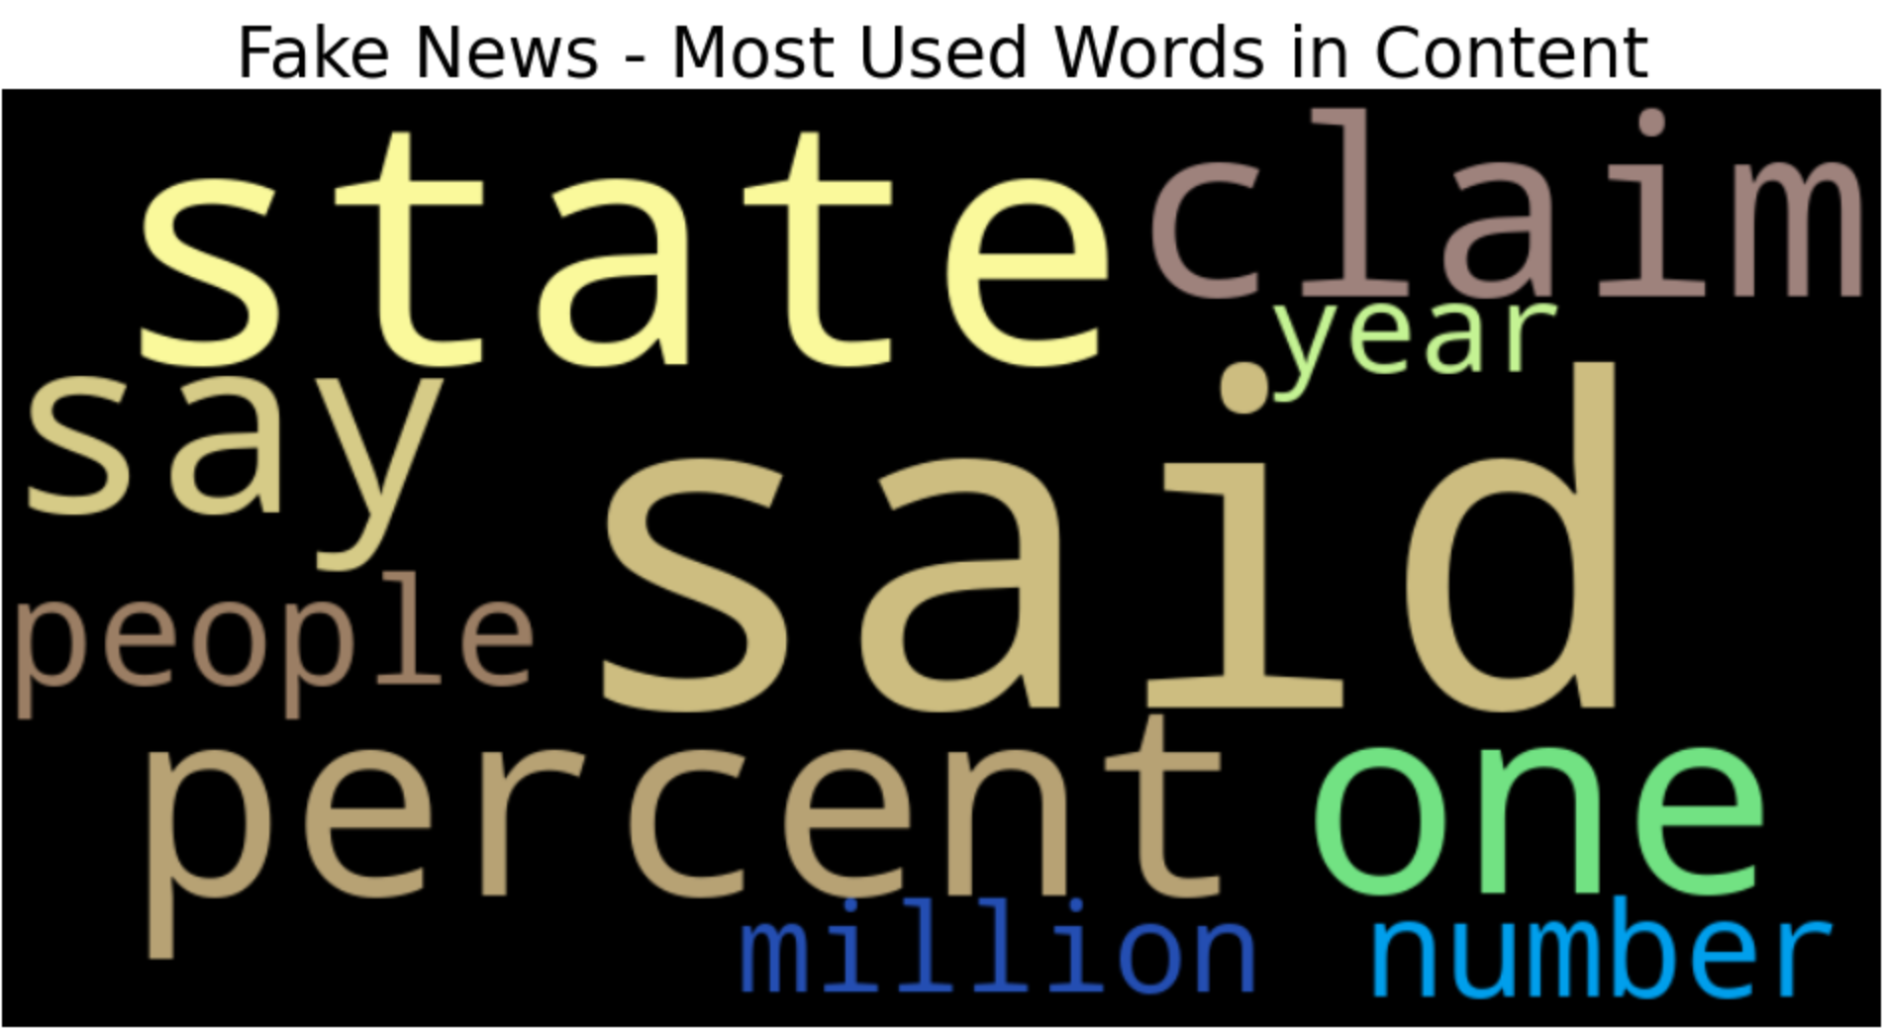
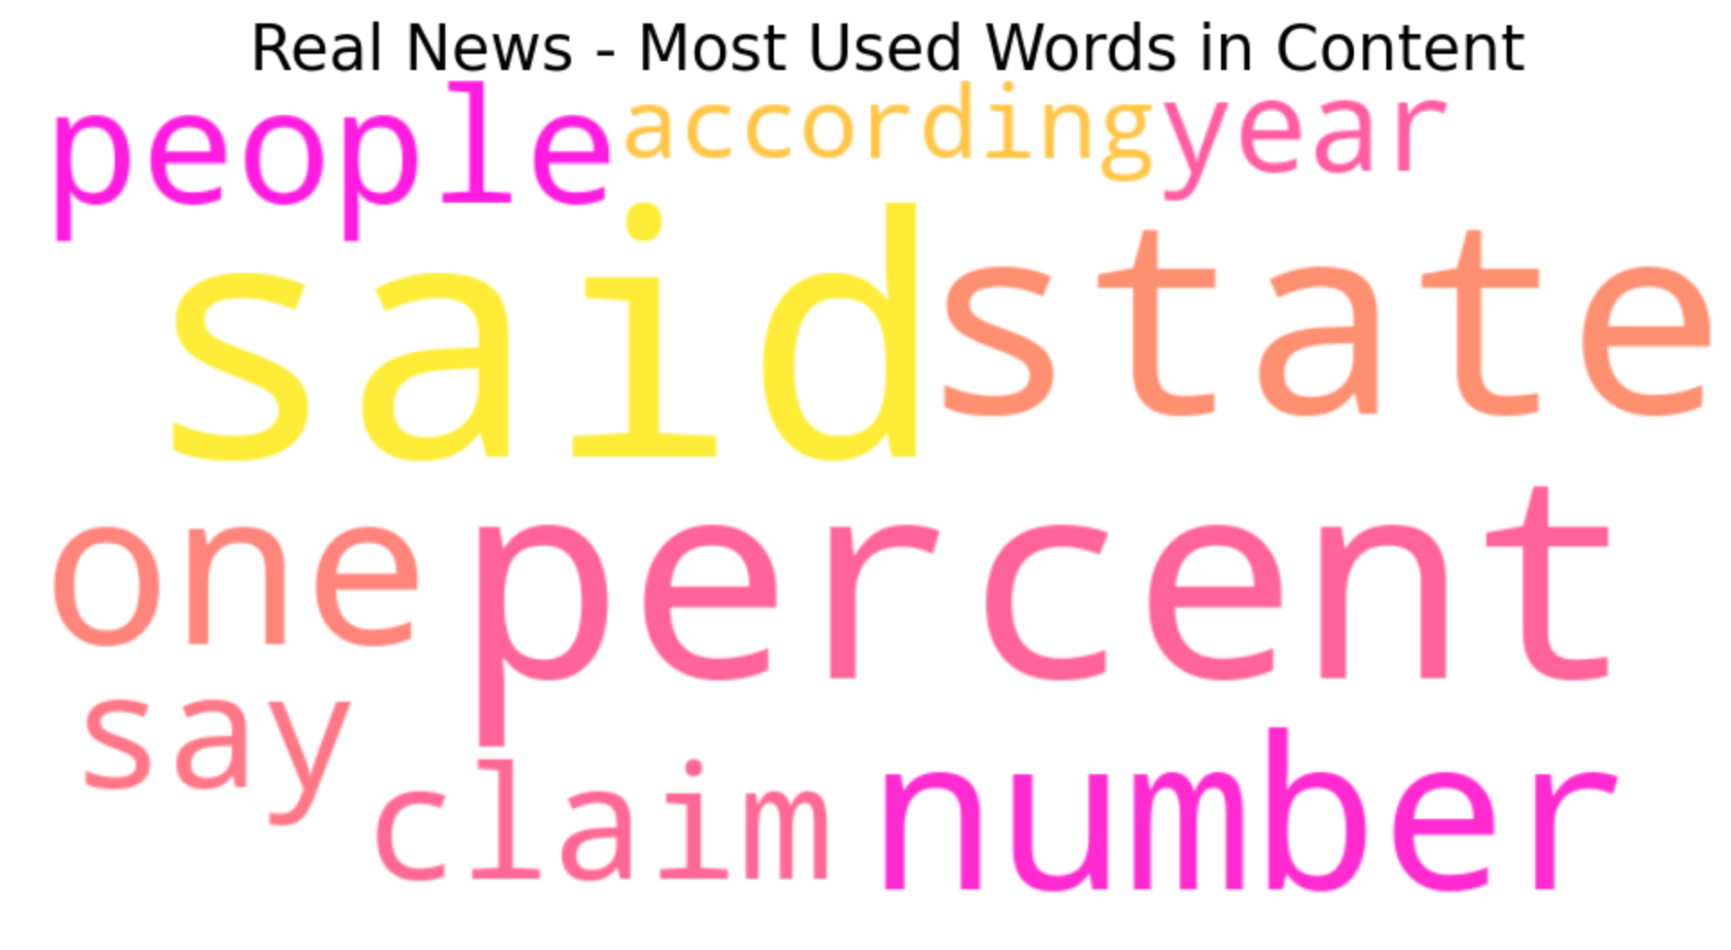
EXPLORATORY DATA ANALYSIS
Top 10 Words in Content with Word Cloud

Slide 6
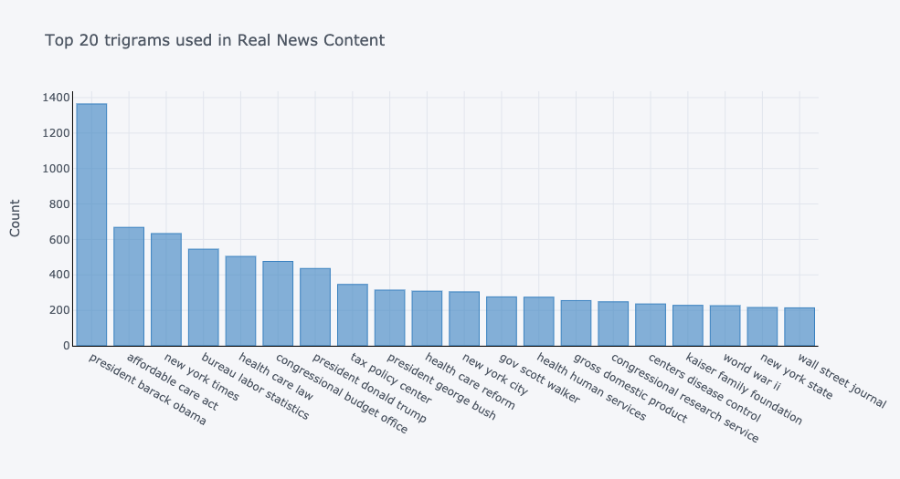
EXPLORATORY DATA ANALYSIS
Top 20 trigrams in Content with CountVectorizer
Economics, government organizations, etc..

Slide 7
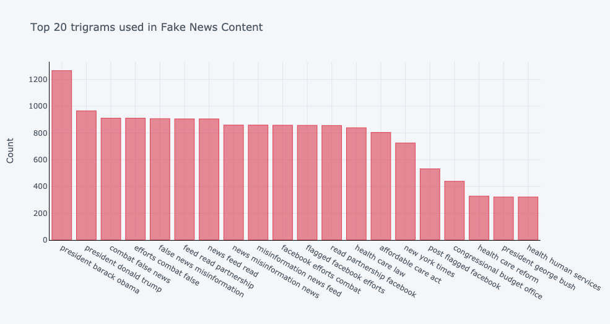
EXPLORATORY DATA ANALYSIS
Top 20 trigrams in Content with CountVectorizer
Combating false news, misinformation, etc…

Slide 8
GridSearch results, Best AUC and F1 score
 | LogReg-CV | LogReg- CV, Ngram (1,3) | NB-CV | NB-CV Ngram (1,3) | LR-TFIDF | LR-TFIDF Ngram (1,3) | NB-TFIDF | NB-TFIDF Ngram (1,3)
AUC Validation | 0.678 | 0.689 | 0.656 | 0.656 | 0.683 | 0.691 | 0.648 | 0.652
Precision Validation | 0.676 | 0.698 | 0.664 | 0.654 | 0.681 | 0.700 | 0.735 | 0.678
Recall Validation | 0.659 | 0.643 | 0.601 | 0.629 | 0.660 | 0.647 | 0.453 | 0.558
F1 Score Validation | 0.667 | 0.669 | 0.631 | 0.641 | 0.670 | 0.673 | 0.560 | 0.612

Slide 9
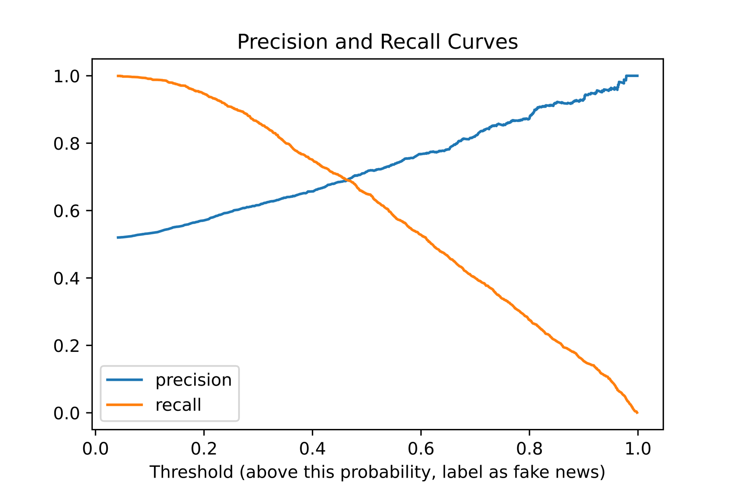
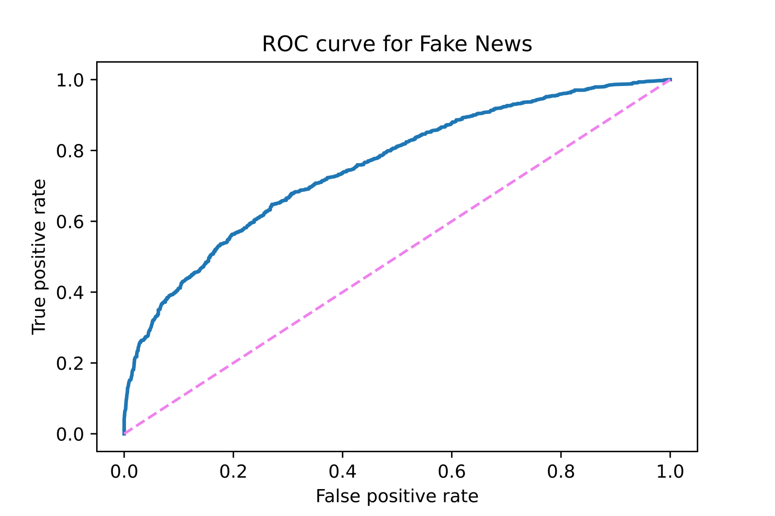
Precision Recall Curve and ROC
Logistic Regression (C = 100) with CountVectorizer Unigram
Select Threshold @ 0.27
AUC Score: 0.7526
Log Loss : 0.5891

Slide 10
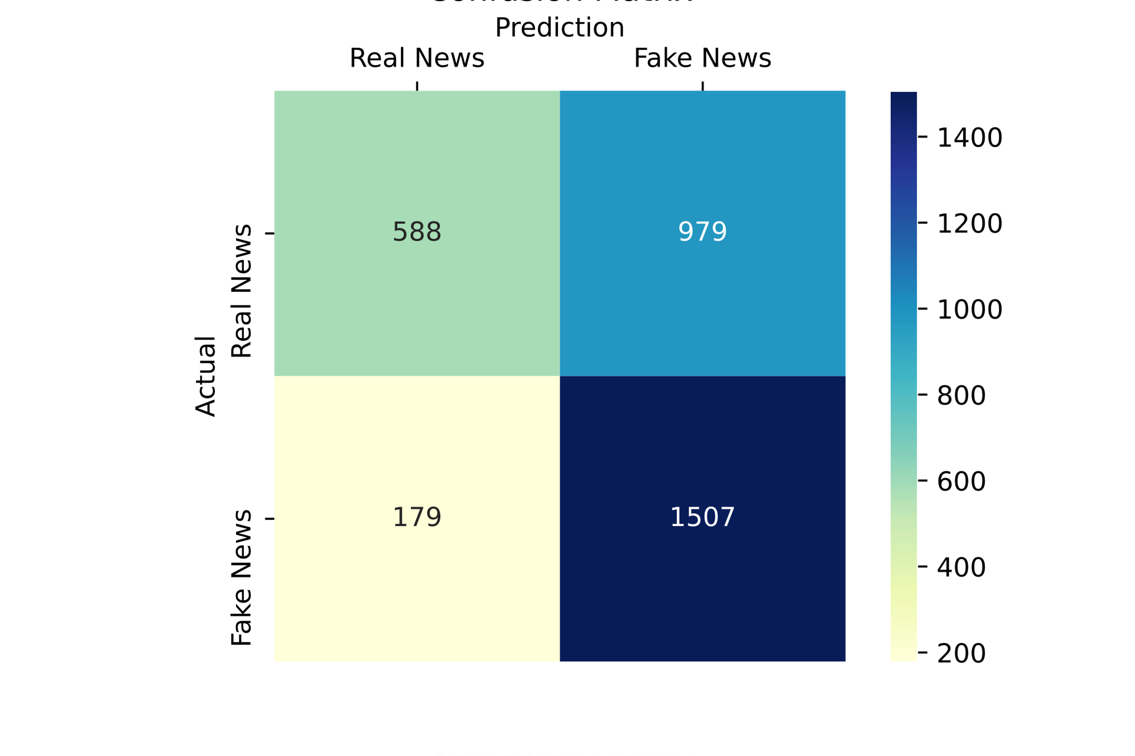
Confusion Matrix
Predict Probability of >= 0.27
Metric | Score
Precision | 0.6062
Recall | 0.8938
F1 score | 0.7224

Slide 11
Topic Modelling
LDA with CountVectorizer Unigram
Topics | Words Captured
Job numbers | years, jobs, data, states, numbers, million, percent,
Government Policies | tax, health, care, income, insurance, plans, people
Presidential campaign | Trump, Obama, president, campaign, state, news, house

Slide 12
Topic camparison among real and fake news
Topic Content | Topic Distribution | Real or Fake
the super pac ending spending fund is broadcas... | (Job numbers, 0.24) (Presidential Campaign, 0.76) | Fake
a widespread internet post claims democratic p... | (Job numbers, 0.19) (Presidential Campaign, 0.81) | Fake
on sept the national taxpayers union a conserv... | (Job numbers, 0.11) (Government Policies, 0.81) (Presidential Campaign, 0.08) | Real

Slide 13

CONTACT
Any questions or clarifications?
danielchang231285@gmail.com

